Slide 1

CPS3123 - Lecture 2
Node Fundamentals - Part 1

Slide 2
Topics
Javascript Refresher
Objects and Object Literals
Node Fundamentals
Modules, Export, Require
Events and Event Emitter
HTTP and being a Web Server

Slide 3
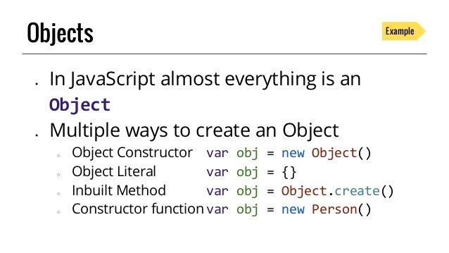
Javascript Refresher: Objects and Object Literals

Slide 4
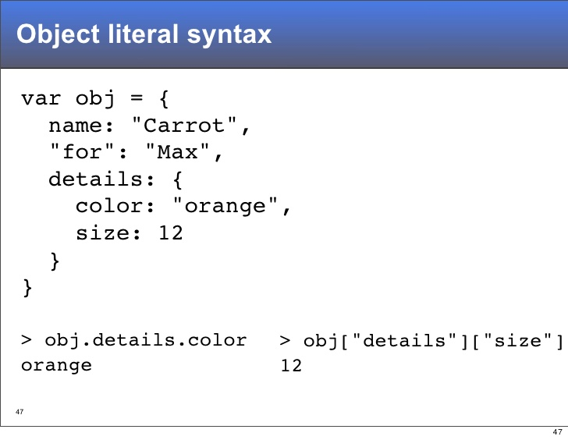
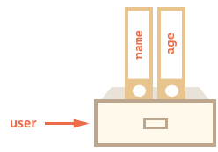
Javascript Refresher: Objects and Object Literals

Slide 5
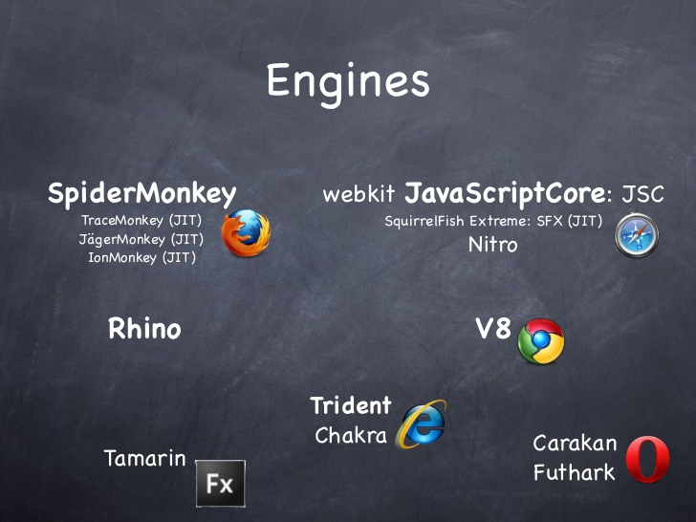
Javascript Engine - Revisited

Slide 6
Modules, Exports and Require

Slide 7
What is a module?
A module encapsulates related code into a single unit of code.
A module is a reusable piece of JavaScript which exports specific objects, making them available for other modules to require in their programs
Each module in Node.js has its own context, so it cannot interfere with other modules or pollute global scope.

Slide 8
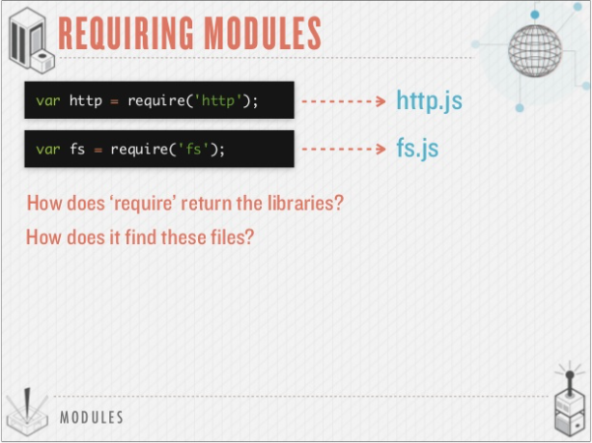
Using require in your application

Slide 9
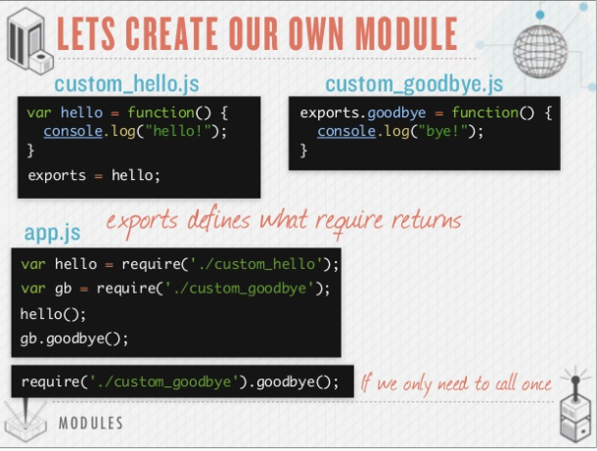
Using modules in your application

Slide 10
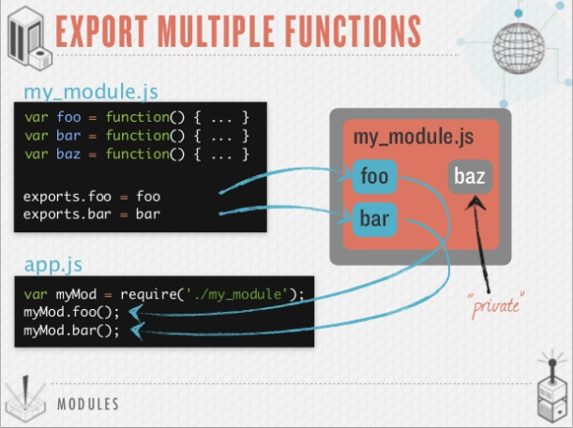
Using modules in your application

Slide 11
Three sources of Node modules
Build-in modules
Come pre-packaged with Node
Are required()’d with a simple string identifier
var f = required(‘foo’);
A sample of built-in modules include:
fs
http
crypto
os

Slide 12

Three sources of Node modules
#2: Your Projects’ files
Each .js file is its own module
A way to modularize your application’s code
Each file is required()’d with file system-like semantics

Slide 13
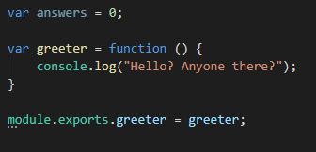
Three sources of Node modules
#2 Your Project’s files
Variables are marked for export via ‘module.exports’ - Q: Is answers variable available to caller?
- There are a few different module export patterns. https://darrenderidder.github.io/talks/ModulePatterns

Slide 14
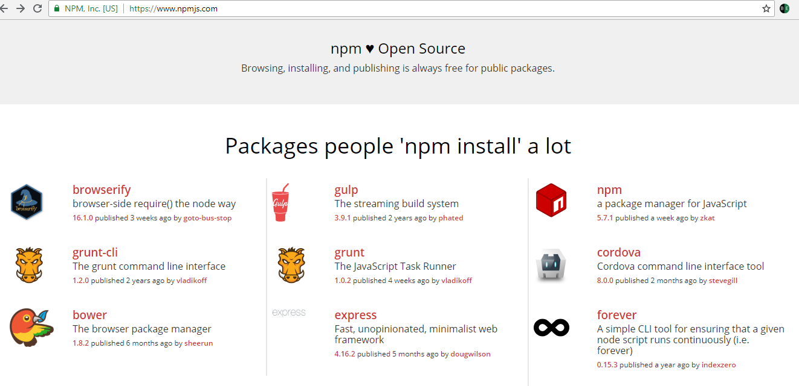
Three sources of Node modules
# 3 Third Party Modules via Node Package Manager (NPM) registry

Slide 15
Three sources of Node modules
# 3 Third Party Modules via Node Package Manager (NPM) registry
Installed via “npm install module_name” into “node_modules” folder
Are required()’d via simple string identifiers, similar to built-ins
var http = require(‘http’);
Some modules provide command line utilities as well
Install these modules with “npm install -g module_name”
Examples include: express, mocha * Note: difference between install -g and install --save

Slide 16
How do do modules really work?
Require is a function, that you pass a path too
Module.exports is what the require function returns
This works because your code is actually wrapped in a function that is given these things as function parameters

Slide 17
Events and Event Emitter

Slide 18
What is an Event Emitter in NodeJs
Node core is based on asynchronous event-driven architecture.
Emitter objects periodically emit events that cause listener objects to be called.
When the EventEmitter object emits an event, all of the functions attached to that specific event are called synchronously.

Slide 19
What is an Event?
An Event is something that has happened in our app that we can respond to.
In Node there are actually two different types of events.

Slide 20
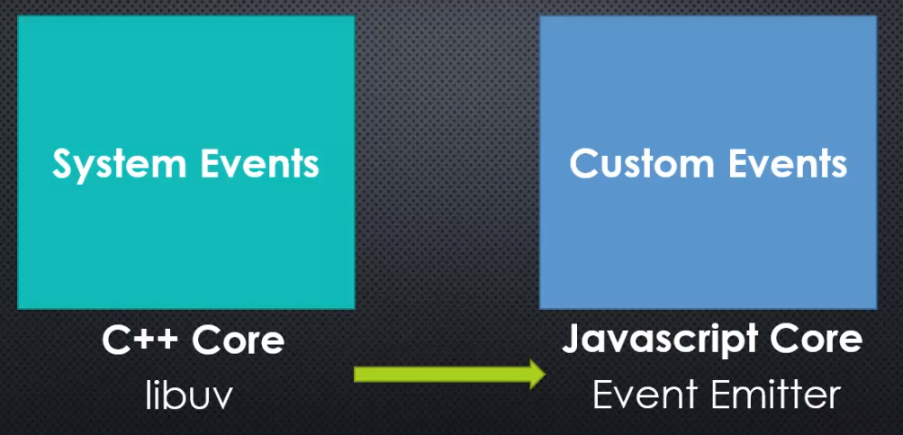
Two different types of events in Node

Slide 21
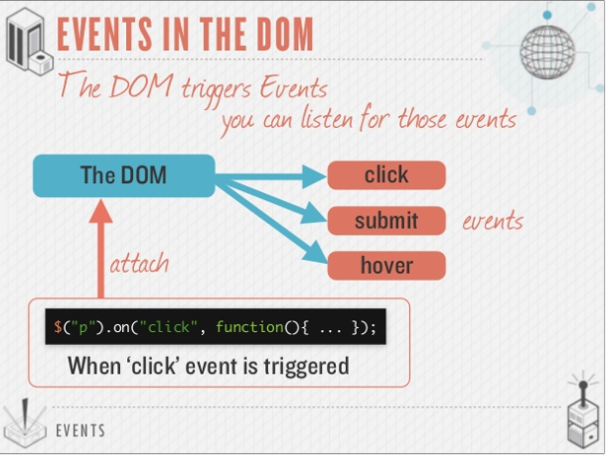

Slide 22
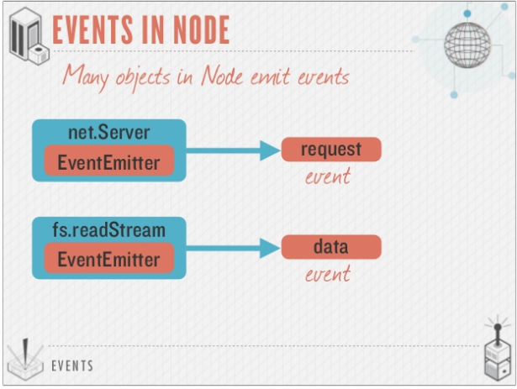

Slide 23
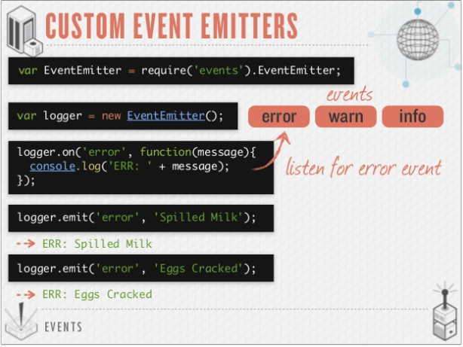

Slide 24
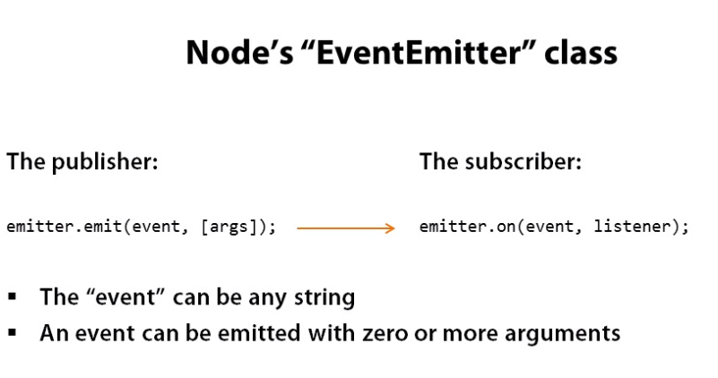

Slide 25
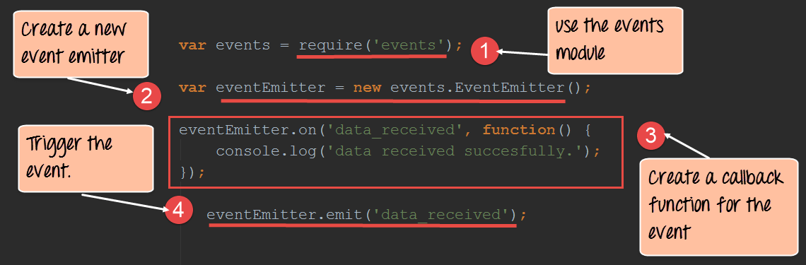
Create a new event emitter

Slide 26
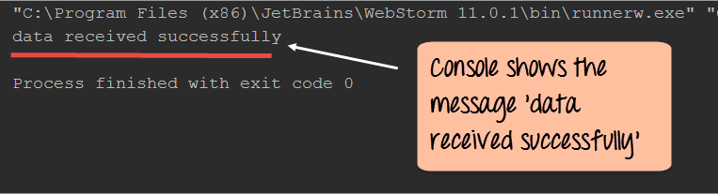
Create a new event emitter

Slide 27
HTTP and being a Web Server

Slide 28
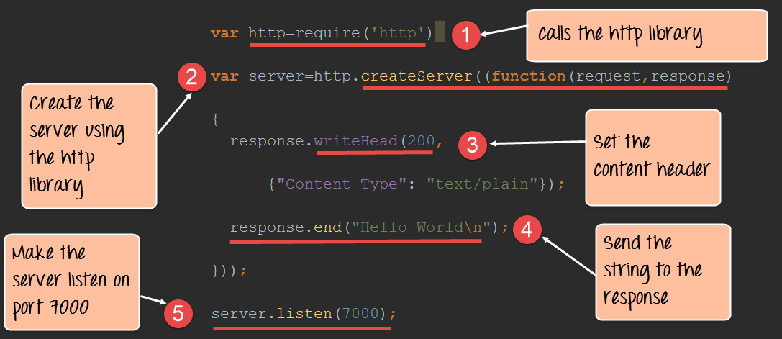
Node as a web server using HTTP

Slide 29
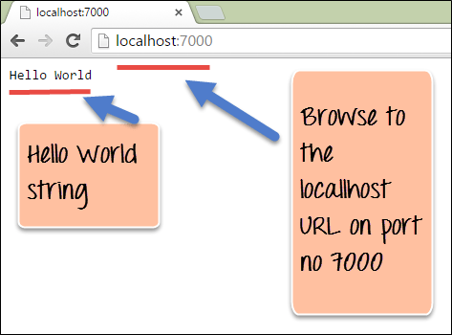
HTTP response output

Slide 30
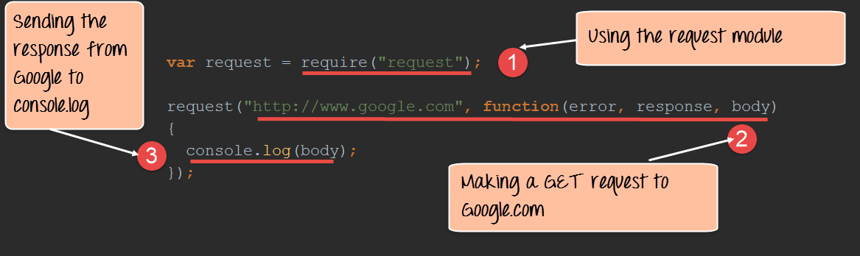
Node as Client: Handling GET Requests

Slide 31
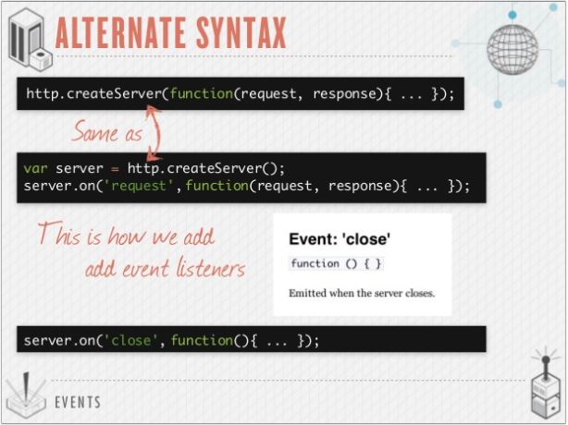

Slide 32

What Node needs to be a web server
Needs to organize code into reusable pieces
Needs to deal with files
Needs to deal with databases
Needs to be able to communicate over internet
Needs to be able to accept requests and send responses
Needs to handle tasks that take a long time

